Slide 1
Port Scanning
Prepared by : SWATI
(28320)

Slide 2
What is port Scanning?
A PORT SCAN is a common technique hackers use to discover open doors or weak points in a network. A port scan attack helps cyber criminals find open ports and figure out whether they are receiving or sending data. It can also reveal whether active security devices like firewalls are being used by an organization.
When hackers send a message to a port, the response they receive determines whether the port is being used and if there are any potential weaknesses that could be exploited.

Slide 3
…
Businesses can also use the port scanning technique to send packets to specific ports and analyze responses for any potential vulnerability. They can then use tools like IP scanning, network mapper (Nmap), and Netcat to ensure their network and systems are secure.
Port scanning can provide information such as:
Services that are running
Users who own services
Whether anonymous logins are allowed
Which network services require authentication

Slide 4
What is a Port?
A port is a point on a computer where information exchange between multiple programs and the internet to devices or other computers takes place.
Port number ranges:- 0 -- 65,536
Ports are generally managed by the Transmission Control Protocol (TCP), which defines how to establish and maintain a network conversation between applications, and User Datagram Protocol (UDP), which is primarily used for establishing low-latency and loss-tolerating connections between applications. Some of the most popular and most frequently used ports include:
Port 20 (UDP): File Transfer Protocol (FTP) used for transferring data
Port 22 (TCP): Secure Shell (SSH) protocol used for FTP, port forwarding, and secure logins
Port 23 (TCP): The Telnet protocol used for unencrypted communication
Port 53 (UDP): The Domain Name System (DNS), which translates internet domain names into machine-readable IP addresses
Port 80 (TCP): The World Wide Web Hypertext Transfer Protocol (HTTP)

Slide 5
NMAP
Nmap ("Network Mapper") is a free and open source utility for network discovery and security auditing. Many systems and network administrators also find it useful for tasks such as network inventory, managing service upgrade schedules, and monitoring host or service uptime.
Nmap uses raw IP packets in novel ways to determine what hosts are available on the network, what services (application name and version) those hosts are offering, what operating systems (and OS versions) they are running, what type of packet filters/firewalls are in use, and dozens of other characteristics.

Slide 6
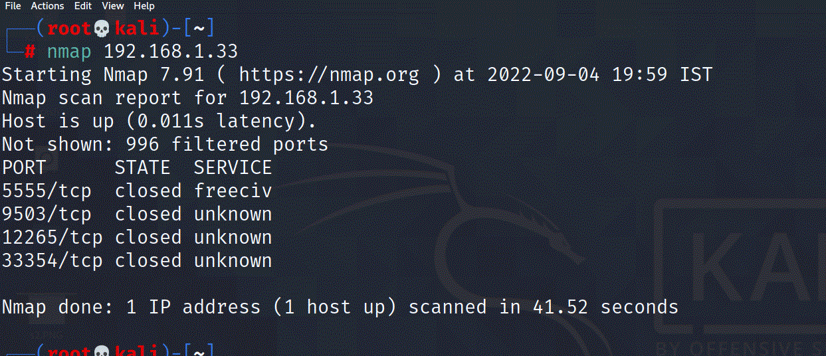
Service Discovery and Nmap
Scan custom TCP/UDP port ranges
1>> nmap 192.168.1.33
Single IP scan going to show you port number, status and services running on same ip.
2>> nmap 192.168.1.32 192.168.1.33
Scan specific IPs
3>> nmap 192.168.1.30-35
Scan IP range

Slide 7
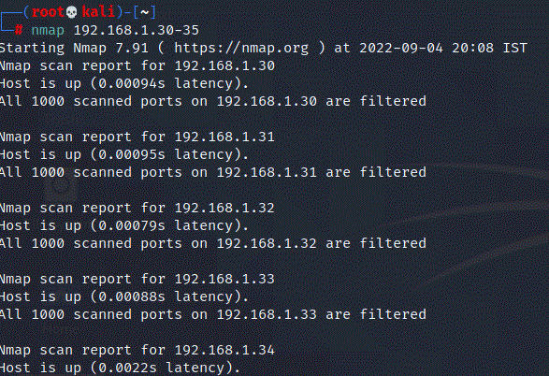
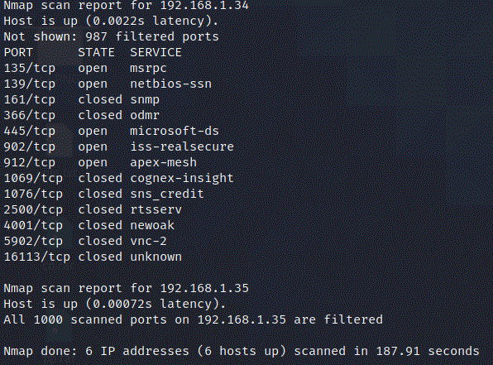
For ip range

Slide 8
Scan Techniques
Option Example Description
-sS nmap 192.168.1.1 -sS TCP SYN port scan (Default)
-sT nmap 192.168.1.1 -sT TCP connect port scan (Default without root privilege)
-sU nmap 192.168.1.1 -sU UDP port scan
-sA nmap 192.168.1.1 -sA TCP ACK port scan

Slide 9
Port specific
Option Example Description
-p nmap 192.168.1.1 -p 21 Port scan for port x
-p nmap 192.168.1.1 -p 21-100 Port range
-p nmap 192.168.1.1 -p http,https Port scan from service name
-F nmap 192.168.1.1 -F Fast port scan (100 ports)

Slide 10
Service and Version Detection
Switch Example Description
-sV nmap 192.168.1.1 -sV Attempts to determine the version of the service running on port
-sV –version-light nmap 192.168.1.1 -sV –version-light Enable light mode. Lower possibility of correctness. Faster
-A nmap 192.168.1.1 -A Enables OS detection, version detection, script scanning, and traceroute

Slide 11
OS Detection
Switch Example Description
-O nmap 192.168.1.1 -O Remote OS detection using TCP/IP stack fingerprinting
-O –osscan-guess nmap 192.168.1.1 -O –osscan-guess Makes Nmap guess more aggressively
-A nmap 192.168.1.1 –A Enables OS detection, version detection, script scanning, and traceroute

Slide 12
Timing and Performance
Switch Example Description
-T0 nmap 192.168.1.1 -T0 Paranoid (0) Intrusion Detection System evasion
-T1 nmap 192.168.1.1 -T1 Sneaky (1) Intrusion Detection System evasion
-T2 nmap 192.168.1.1 -T2 Polite (2) slows down the scan to use less bandwidth and use less target machine resources
-T3 nmap 192.168.1.1 -T3 Normal (3) which is default speed
-T4 nmap 192.168.1.1 -T4 Aggressive (4) speeds scans; assumes you are on a reasonably fast and reliable network
-T5 nmap 192.168.1.1 -T5 Insane (5) speeds scan; assumes you are on an extraordinarily fast network

Slide 13
THANKS

